Slide 1
Recursion and
Data Structures

Slide 2
Topics and Concepts used Today
Recursion
Data Structures:
Arrays
Linked Lists
Stacks and Queues
Basic Java File I/O
Time Complexity
GitHub

Slide 3
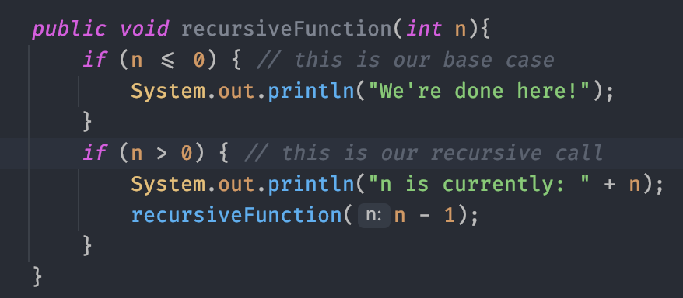
What is Recursion?
Recursion is the process of a function calling itself either directly or indirectly.
This is a very powerful tool for solving problems which are inherently recursive (defined by itself).
Some examples of this are:
Factorials n * (n - 1)!
Traversing linked nodes in a data structure
Calculating fibonacci numbers (Do not do this!)
Recursion in Java example

Slide 4
Rules of Recursion
There must be base cases which can be solved without recursion
Recursive calls must always make progress towards the base case
Never duplicate work by solving same instance of a problem in separate recursive calls

Slide 5
Suppose we wanted to traverse the file system of a computer using recursion. How would we go about solving this problem?

Slide 6
Data Structures!
Data structures are tools that developers use organize and access data.
Arrays and Linked-Lists are the two most common and important types.
From these fundamentals we can build more complex Data Structures, such as Trees, Graphs, and Hash Maps

Slide 7
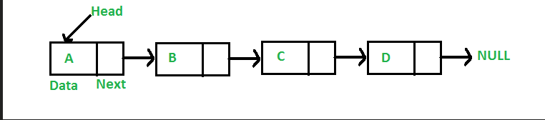
Linked-Lists
A data structure where each Node has two parts:
The information (data) it’s storing
A pointer to the next node in the list

Slide 8
Additional Functionality of Arrays and Linked Lists
Stack
A stack is a data structure which stores data in a “First in, Last out” fashion.
The stack has the methods:
push()
pop()
top()
isEmpty()
isFull()
Queue
A stack is a data structure which stores data in a “First in, First out” fashion.
The queue has the methods:
enqueue()
dequeue()
front()
isEmpty()
isFull()

Slide 9
Homework
Implement a Stack and Queue data structure which uses each method we talked about
Implement the Queue using an array
Implement the Stack using a linked-list

Slide 10
Homework and Additional Practice
Recursion
https://codingbat.com/java/Recursion-1
https://www.leetcode.com
Data Structures
https://home.cs.colorado.edu/~main/questions/chap03j.html
https://home.cs.colorado.edu/~main/questions/chap04j.html
Additional Reading
Textbook: Data Structures and Algorithms in Java (3rd Edition)
All code used in the book is available here: https://users.cs.fiu.edu/%7Eweiss/dsaajava3/code/

